Slide 1

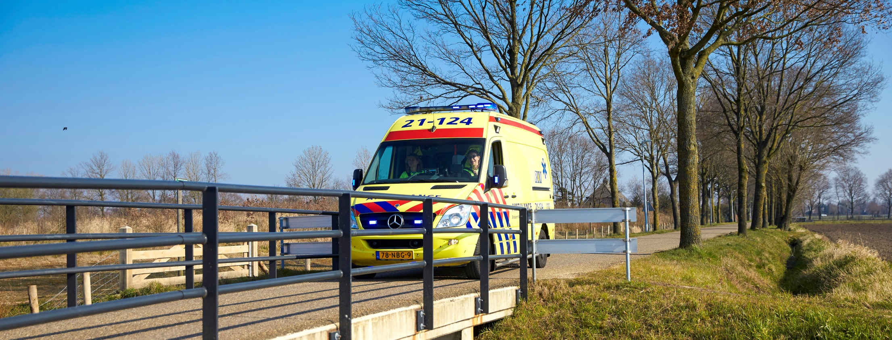
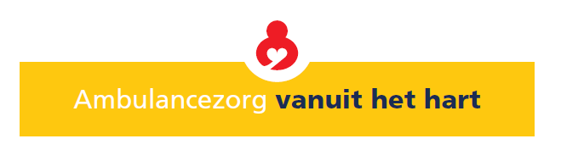
Ambulance care from the heart

Slide 2
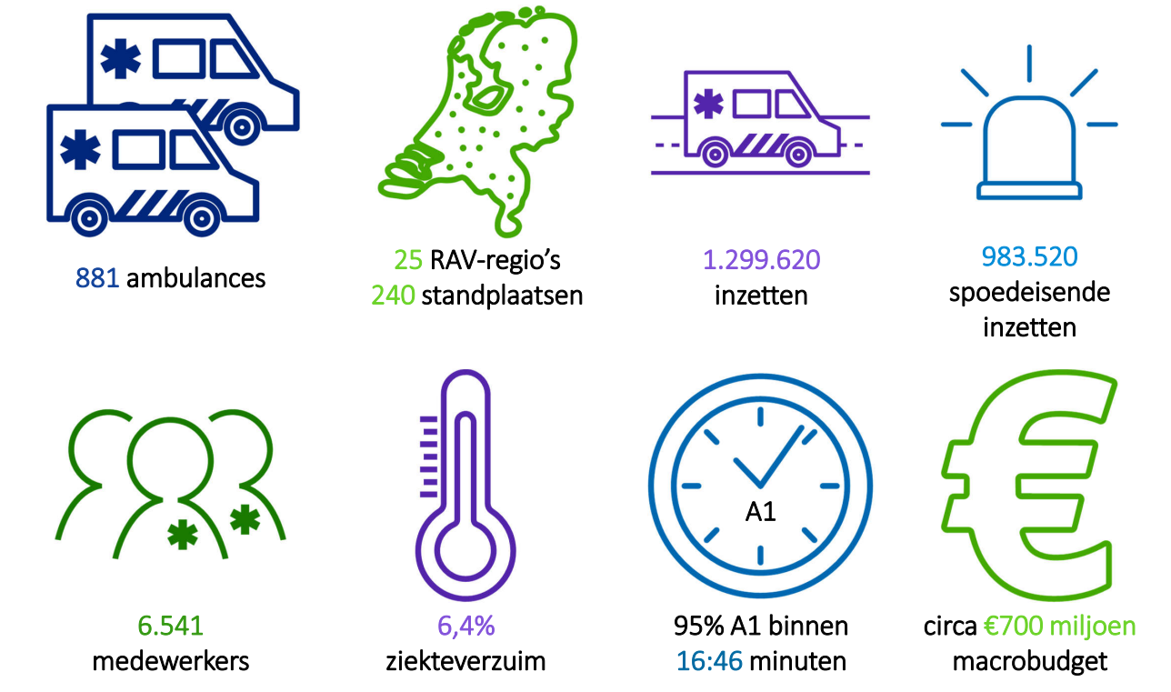
Ambulance services in the netherlands
Regions
stations
calls
urgent ambulance care
17.5 million citizens
within
million
employees
Sickness percentage
minutes

Slide 3
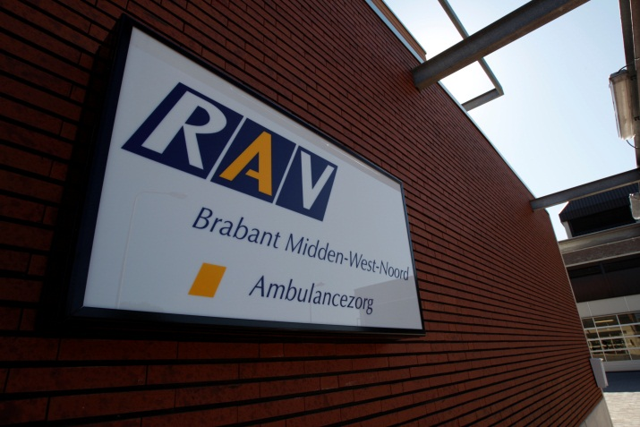
Organization
Type of Company: Common agreement by 36 communities
Company contains 2 regions:
RAV Midden- en West-Brabant
RAV Brabant-Noord

Slide 4
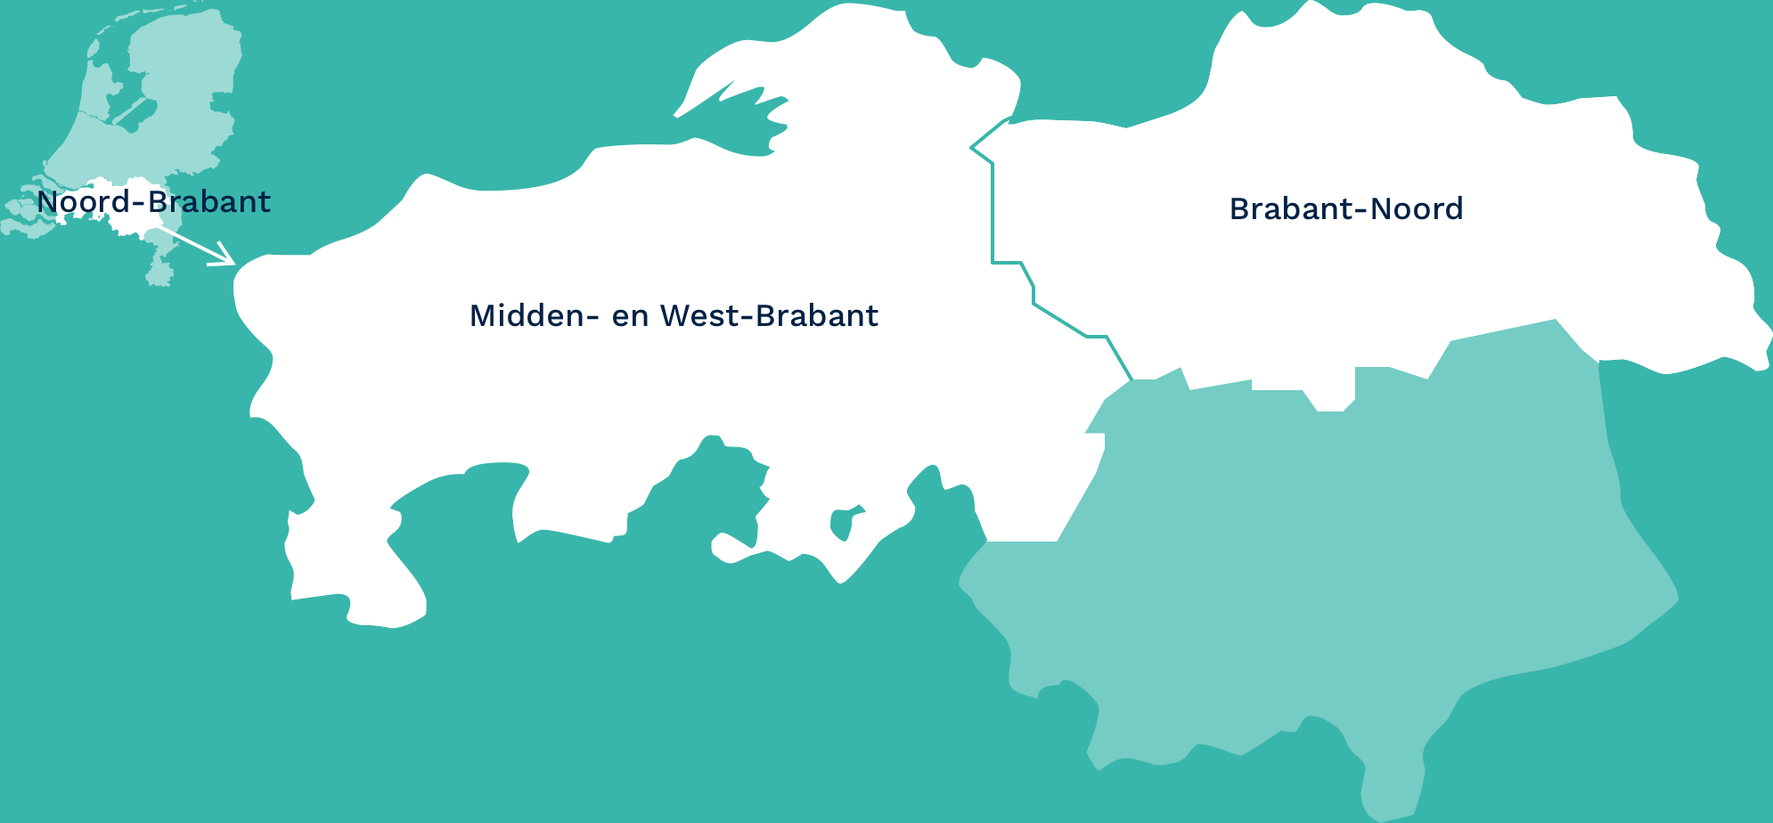
Service area
Netherlands

Slide 5
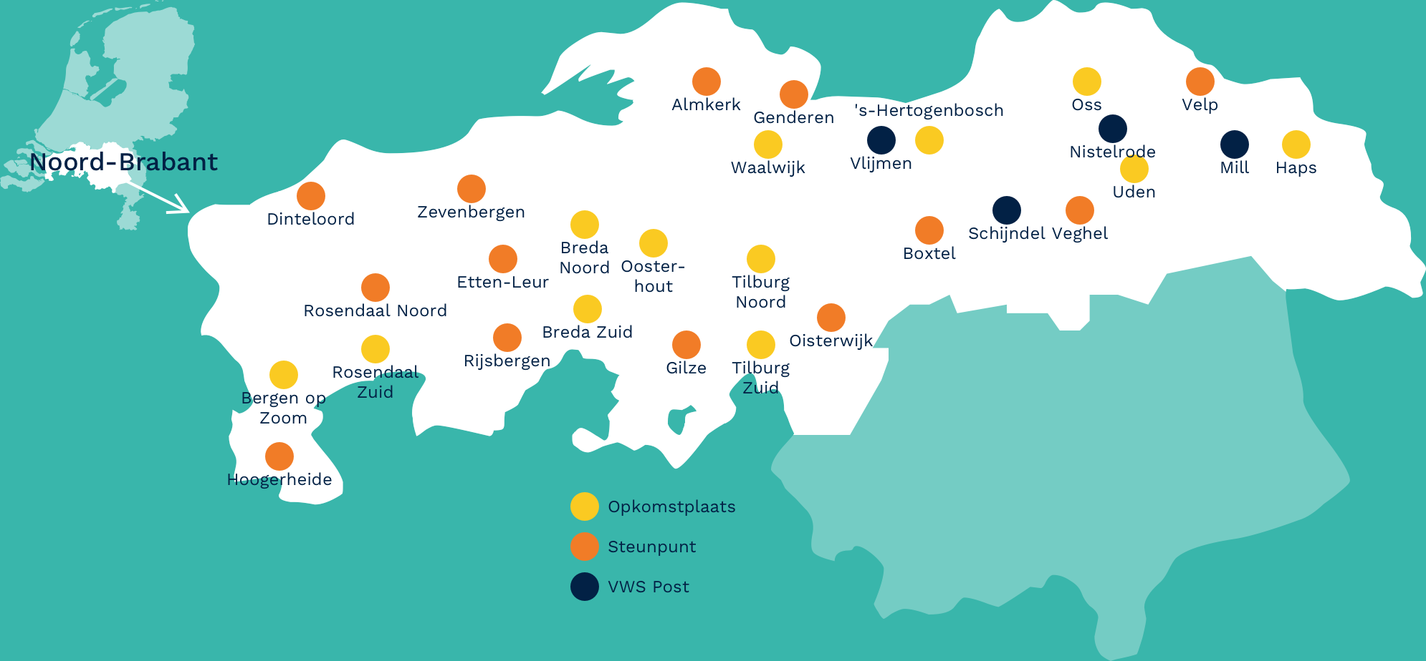
Ambulance stations
The Netherlands
ambulance station
Support station
Support station

Slide 6
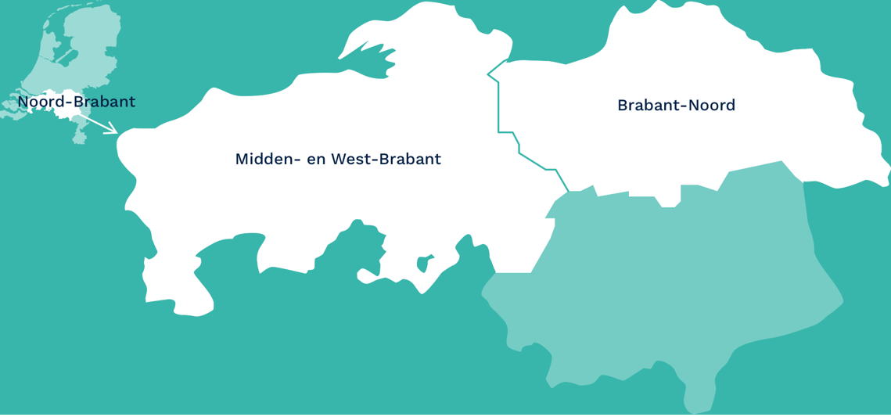
Service area
36 municipalities
Population: 1,8 million people
Surface area: 3,65 km²
2 Dispatch Centers in Bergen op Zoom and Den Bosch
24 ambulance stations
679 employees
70 ALS ambulances
15 BLS ambulances
10 rapid responders

Slide 7
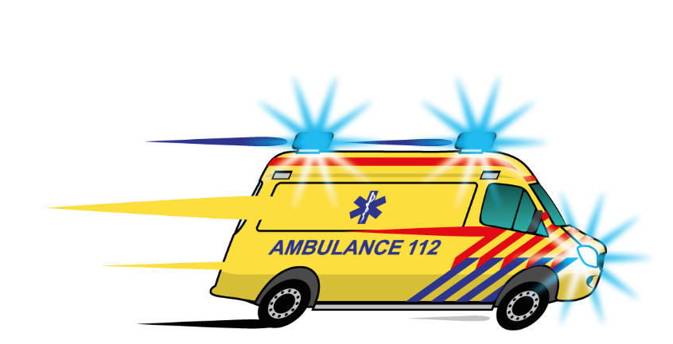
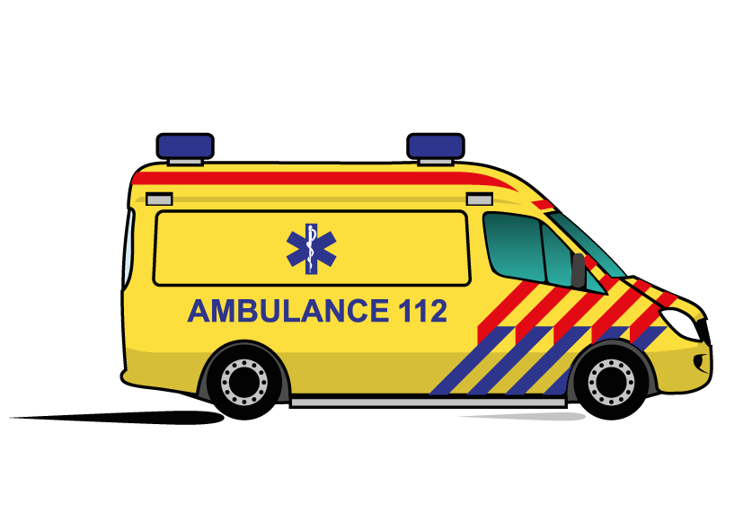
Number of ambulance runs in 2021
Urgent: 107.593
Non urgent: 28.198

Slide 8
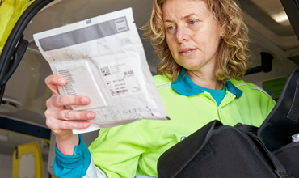


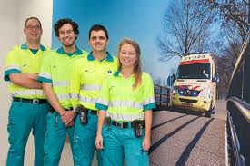
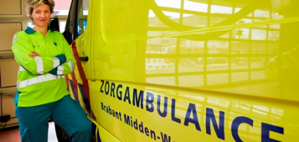
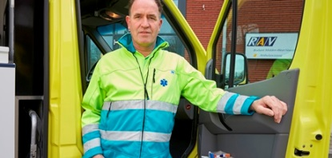
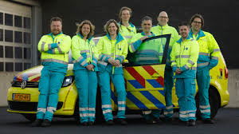
Employees RAV Brabant MWN
232 Ambulance Nurses
Dutch Ambulance Academy
Educated in IC-ER-CCU
Rapid responder
207 Ambulance Drivers
First aid and CPR registration
Car and truck drivers licence
Dutch Ambulance Academy
52 Dispatchers AMPDS
Diploma medical dispatch
Dutch Ambulance Academy
23 Bachelor Medical Professionals
Registration NVMBH
BIG-registration
Positive assessment traineeship
38 non urgent ambulance nurses
Nurse Level 4
Nurse experience
30 non urgent ambulance drivers
First aid and CPR registration
Car and truck drivers license
13 Nurse Practitioners
Pilot first responders
Medical staff
Training / evaluation
84 management, staff and support employees

Slide 9
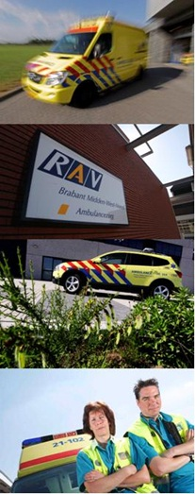


Thank you very much for your attention!

