Slide 1

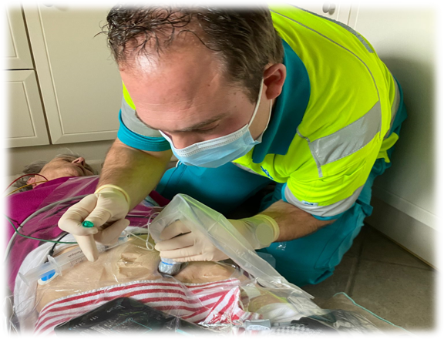
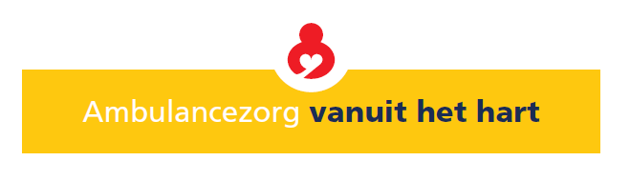

Fascia Iliaca Compartment block in patients ​
with a suspected proximal femur fracture performed
by nurse practitioners-EMS (preliminary data)
Lennert Breedveld MSc
Nurse Practitioner
Ambulance care from the heart

Slide 2
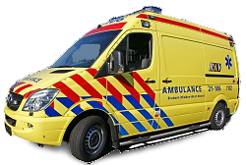
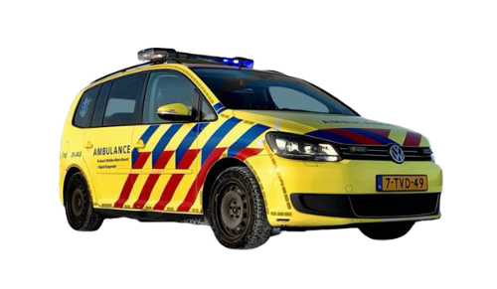
Situation
EMS-Nurse
Nurse Practitioner-EMS
Analgesia:
Esketamine 0.25mg/kg i.v.
Fentanyl 0.02mg/kg i.v.
Analgesia:
Dilution:
20 ml Lidocaine 1% / 1ml adrenaline 0.1mg/ml
Dosage 0.3ml/kg

Slide 3
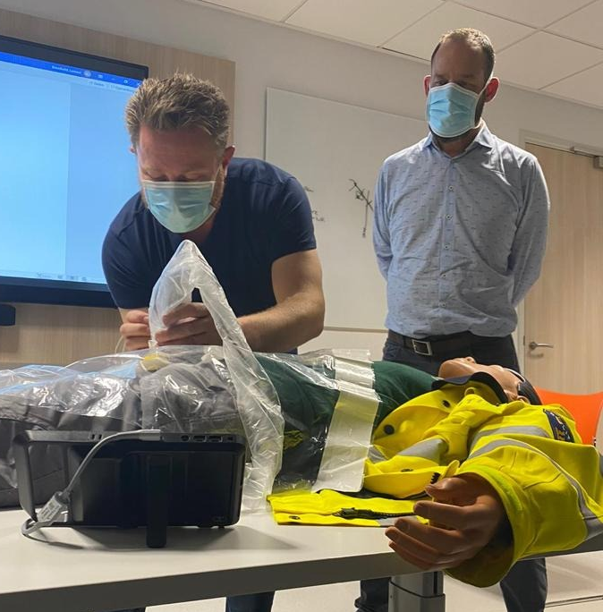
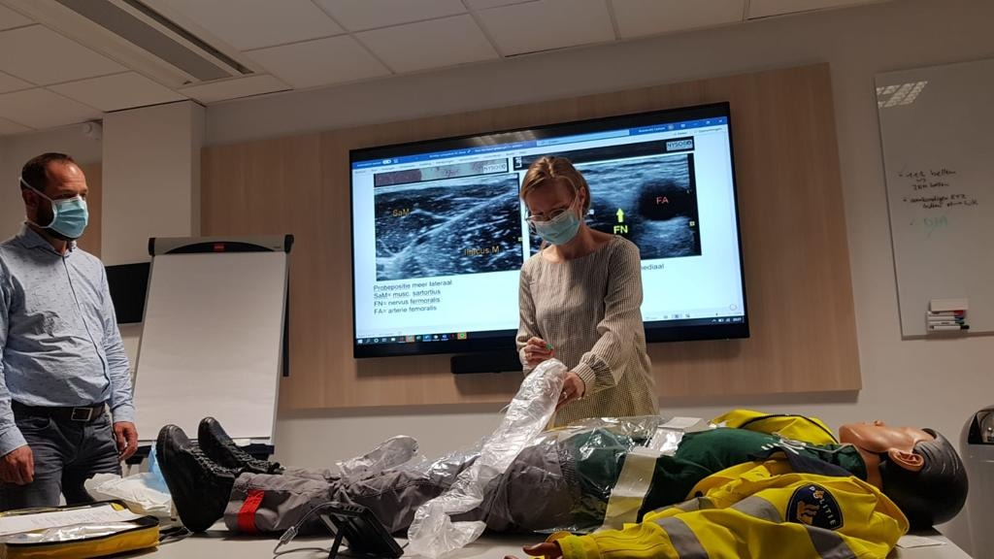
Method & training

Slide 4
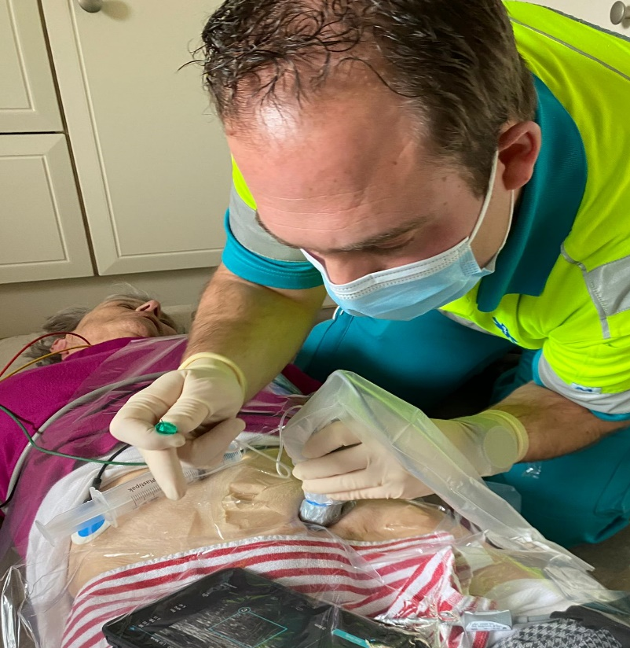
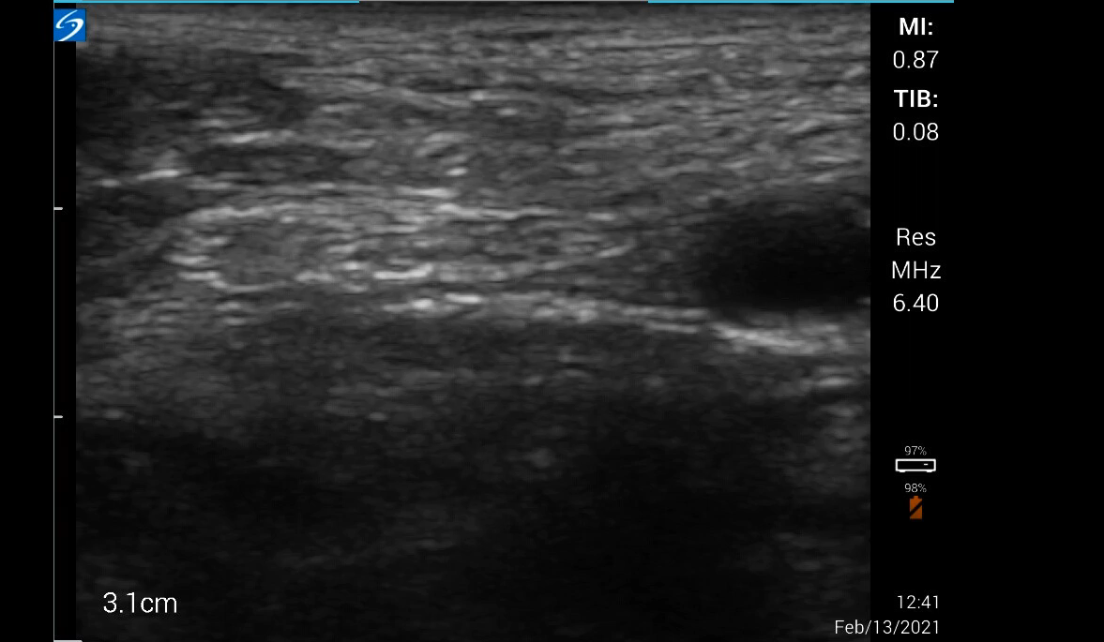

Method & Procedure

Slide 5


PATIENT ChARACTERIStics
patient statistics
Median age: 82
67 31

Slide 6
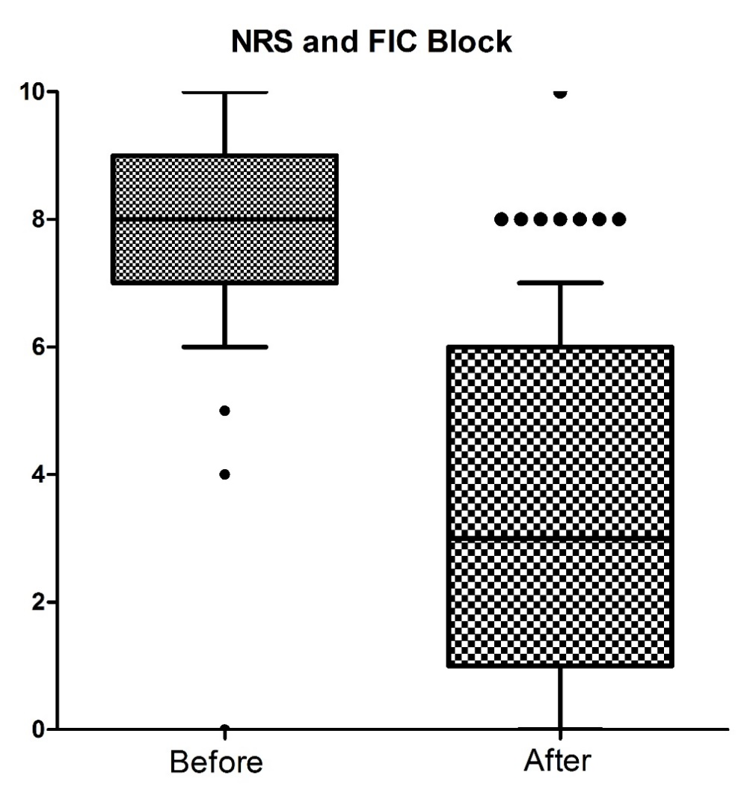
Preliminary Results
Population 99 patients
1 NRS data lost (98)
Effectivity in 96 patients

Slide 7
Conclusion
Well-trained NP-EMS can successfully and effectively perform an
US-guided fasci iliaca block for providing adequate pain relief
in patients with a suspected proximal femur fracture
in the pre-hospital setting.
J.L.T. Breedveld MSc*¹, G.J. van Geffen MD PhD.²,
C.W. van Vliet MSc¹, E. den Boer MANP¹, A.A.J. Heutinck MSc¹,
X.R.J. Moors MD, PhD.¹, C. Slagt MD PhD.²
¹Regional Ambulance Service Brabant Midden-West-Noord, Den Bosch, The Netherlands;
²Radboud University Medical Centre, Nijmegen, The Netherlands.

Slide 8
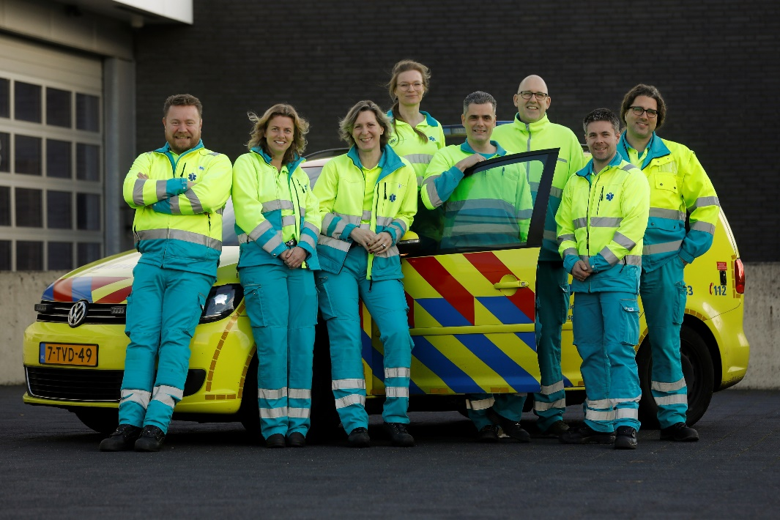



Thank you for your attention!
More information about our research:
www.ravbrabantmwn.nl/vs-english/
Let's keep in touch!
/lennertbreedveld/
Lennert___ l.breedveld@ravbrabantmwn.nl

